Slide 1
Addressing Poor Mental Health in Construction
Daisie Rees-Evans
Policy Officer at the Chartered Institute of Building (CIOB)
Notes:
Previously worked as a mental health coach helping people understand and manage their mental health
Now Policy focusing on conducting research around important issues that affect the built environment
Today I’ll talk through the research we conducted recently and how the findings of the report has helped guide the CIOB to address poor mental health.

Slide 2
Background
Significant focus on improving health and safety on-site over the last 10-15 years, but mental health has been neglected
Office for National Statistics (ONS) indicate males in construction are 3 times more likely to commit suicide
Trends show that construction workers are now more likely to die from suicide than falling from height
Important for the CIOB to understand the state of mental health in construction and factors that negatively contribute towards it
Notes:
Construction has improved its record on health and safety over the last 10-15 years, but people’s mental health and wellbeing has been somewhat neglected. With ONS figures showing that males working in construction are 3 times more likely to commit suicide.
We now see workers more at risk of committing suicide than falling from height, and so while strides have been made in physical safety, mental health risks have not received the same level of attention until more recently.
In 2019 our President, Professor Charles Egbu, made it one of his priorities to raise awareness of poor mental health within the industry. The CIOB’s message was clear. To truly be a professional in the built environment, there must be recognition and care paid to the wider workforce, regardless if they are a close colleague or a subcontractor that you only see for a day or two. And This requires a major cultural shift in our industry.
To fully understand the state of mental health in construction and what factors contributed towards poor mental health, the CIOB conducted a large survey of workers in the industry.

Slide 3
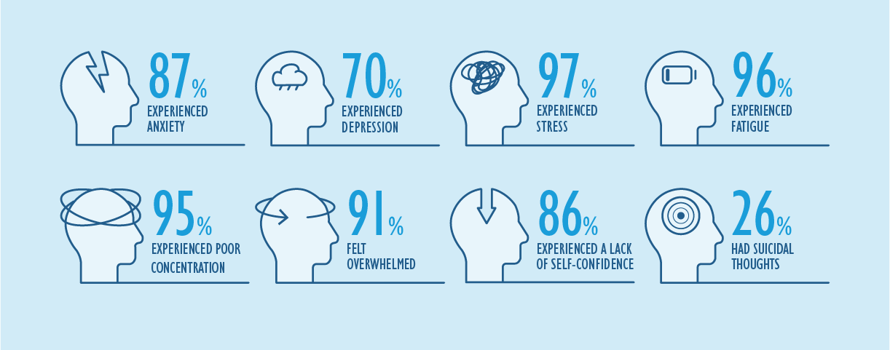
Over the past year...
Notes:
The survey was conducted in October 2019, before the pandemic occurred and we received 2081 responses from those working within the built environment around the world.
Some of the headline statistics can be seen here.
Worryingly we saw over a quarter (26%) of respondents say that they had experienced suicidal thoughts at least once in the past year and we anticipate these mental health issues have been exacerbated due to the pandemic and uncertainty around job, health and finance.
We also saw 97% of people say that they had felt stressed at least once and, as some of you may know, prolonged stress can often have a negative impact on worker’s productivity, physical and mental health.
To explain this a bit further…[next slide]

Slide 4
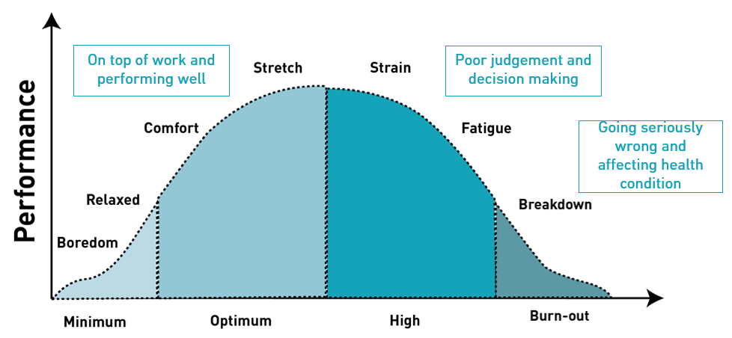
Stress Graph by Mates in Mind
Notes:
The stress graph by Mates in Mind illustrates how the level of stress can impact an individual’s performance at work.
A moderate amount of stress can put people in the right mindset to tackle work, but the if the amount of stress increases this is detrimental to the individual’s concentration, productivity and mental health. If someone is experiencing too much stress for a prolonged period then it can cause them to feel fatigued, irritable and affect their reasoning, judgement and decision-making skills.
Ultimately too much, or prolonged stress, can lead them to feel burnt-out and develop serious health problems.
From our survey we found that unrealistic deadlines, time pressures and having too much work to do were large contributors to feeling stressed at work. This is quite consistent across the whole of the built environment and is a pertinent challenge for the industry to address.

Slide 5
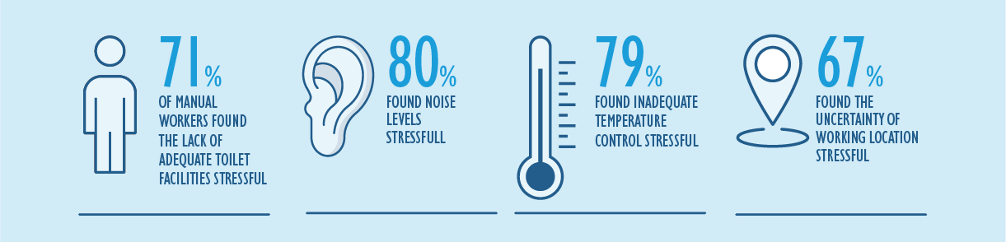
Physical work environment
Note: These statistics may not be generalisable to the construction population, due to the number of responses received. Only 5% of the responses came from manual labourers, 5% from supervisors, 51% from middle management and 33% from senior-level staff.
Notes:
Previous research suggests that there are aspects within the physical work environment that play a part in an individual’s mental health. We spend almost a third of our time at work and the nature of construction means it is often site-based, temporary and can vary from project to project on the quality of facilities.
In our report we found that noise levels, inadequate temperature control and uncertainty of working location was stressful for many. Our research also showed that 71% of the manual workers found the lack of adequate toilet facilities stressful. Our sample size for manual workers was quite small so it is difficult to generalise but our findings are backed up by other studies such as Unite who have found similar results, that a lack of hygiene facilities was a cause of stress for those working on site.
With the ongoing pandemic, it is now more important than ever to allow all workers access to hygienic and safe working facilities on-site and we hope this move continues long after the pandemic.

Slide 6
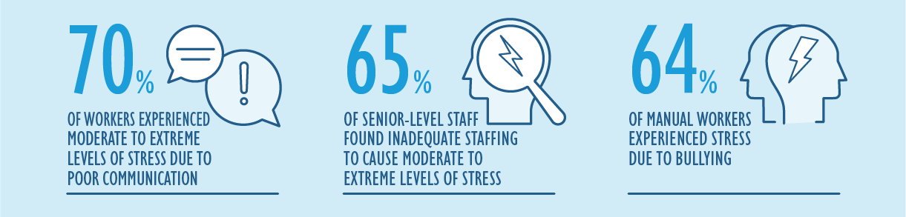
Over the past year...
Notes:
We looked at a variety of work factors that could be contributing to workers stress levels including levels of communication, staffing and workplace bullying. It is no surprise that poor communication can cause high levels of stress and for our members who deal with a range of people in the design process, from clients, to architectures, and to those working on site – communication is a big part of their work.
You can see here that 65% of senior level staff experienced moderate to extreme levels of stress due to inadequate staffing – an ongoing issue for many construction companies.
And although the industry has taken a stance on bullying, over half of manual workers are still experiencing stress due to bullying on sites.
Communication and collaboration is key and the industry is waking up to the need to improve its levels of communications and collaboration during the pandemic. It has been great to see that our industry has really come together to work through the pandemic and we hope this improvement in communication has set a new standard for those working in construction. By improving communication and collaboration this could have a positive knock-on effect for staffing levels and reducing workplace bullying which is always a good thing.

Slide 7
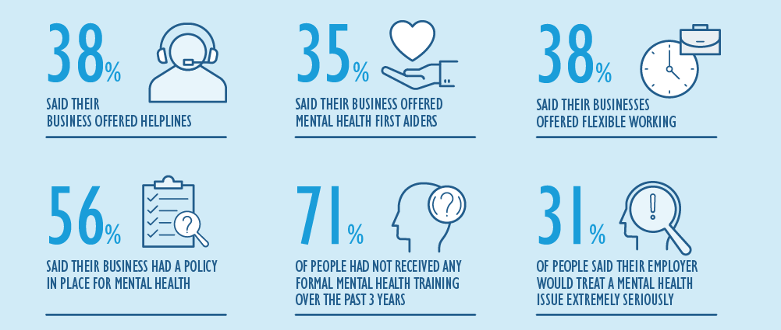
What are companies doing about mental health?
Notes:
Although the statistics seem shocking, there is clearly greater recognition of mental health than ever before and employers must be at the heart of it as they will know their workforce best and the cultural shift that needs to happen.
Within our survey we asked people to tell us what their employer was doing to tackle poor mental health and wellbeing in the workplace.
You can see that some offered helplines, mental health first aiders and flexible working to accommodate people’s needs. Which is a step in the right direction for providing people with some support. However, we found that 71% had not received any formal mental health training over the past 3 years. Which was quite surprising.
Additionally, many did not feel that if they disclosed to their employer that they had a mental health issue it wouldn’t be treated seriously. Only 31% said that they felt theirs would treat it extremely seriously. Meaning leaders in the industry need to do more to help people feel comfortable speaking about their mental health and employers need to demonstrate that they will do their best to support any employee with an issue whether that’s a physical one or a mental one. This is something we have embedded at the heart of the CIOB, setting up our own mental health first aiders scheme internally and partnering with Anxiety UK to ensure that we are helping to reduce this figure as much as we can both for our own staff and for the construction industry.

Slide 8
Report Recommendations
Develop mental health and wellbeing awareness among members, to increase understanding and reduce stigma e.g. through Massive Open Online Courses (MOOCs)
Support businesses of all sizes (including sole traders) in implementing good mental health and wellbeing practices in the workplace
Train managers and supervisors in mental health awareness, and promote effective people management
Ensure employees have access to high-quality mental health support and training
Professional Bodies
Government
Industry
Recommendations from the “Understanding Mental Health in the Built Environment”
www.ciob.org
Notes:
The pandemic has no doubt impacted many people’s mental health over the past year and it is now more important than ever that we address this silent crisis within the industry. Tackling this agenda means that we all have a responsibility to work together as it is not a one-size fits all solution.
In the report we made recommendations for professional bodies like ourselves, government and industry to start thinking about ways we can start to improve poor mental health in the built environment.
To see the full list of recommendations I encourage you to read the report on the CIOB’s website.

Slide 9
Ongoing activity:
Mental Health in Construction MOOC (Massive Open Online Course)
  Search ‘Future Learn Mental Health in Construction’
Globally-applicable mental health resources, that will increase understanding and reduce stigma within construction
Provide guidance that will allow members to manage their own mental health within the workplace
Notes:
As I mentioned at the start, the CIOB believe that to truly be a professional in the built environment, there must be recognition and care paid to the wider workforce, regardless if they are a close colleague or a subcontractor that you only see for a day or two. And This requires a major cultural shift in our industry.
Professional and trade bodies have a duty to promote and guide maintaining good mental health while at work. For the CIOB we have taken several steps to improve the understanding of mental health and wellbeing.
The first step on this journey was the Benevolent Fund and our partnership with Anxiety UK which Dave will cover in his presentation. But in essence both our present and past members as well as their families are able to access free financial and mental health through the fund.
With the report highlighting how little training people in the construction industry have received on mental health awareness and managing mental health we wanted to create a course which was free for all of those in the industry around the globe and not just for our members. In October 2020 we launched the MOOC which is free for anyone to access on FutureLearn’s website. The course covers the foundation of what mental health is, tools to help manage mental health at a personal level but also at an organisational level.
This course has received high praise and have even inspired some construction organisations to start looking further into their own wellbeing practices. Which ultimately helps to create that culture of change by enabling managers and supervisors to understand mental health and become more compassionate leaders.
The CIOB has a range of globally applicable mental health training and guidance in our CPD library and a recent contribution was from Alzheimer's UK covering how this impacts the ageing population in construction.

Slide 10
What’s next?
Notes:
We are going to need large numbers of workers over the next few years as the construction industry is crucial for the recovery from the pandemic. The built environment needs to become a more attractive and inclusive place to work that takes peoples physical and mental health into account whether they are there on-site or in an office.
Instilling mental health practices in the workplace can be daunting and we hope the recommendations we made in the report will help provide industry with food for thought on initiatives they can use in their own organisation. Additionally, we encourage people to use the free resources that are out there already whether that’s CIOB content or content from mental health charities. There is a wealth of information out there that leaders in construction can utilise to start making a positive change to their workforce wellbeing and lives.
Thank you.

